Slide 1
Economics for Leaders
Activity: Magic of Markets

Slide 2
5 Economic Reasoning Propositions
People Choose, and individual choices are the source of social outcomes.
Choices impose costs; people receive benefits and incur costs when they make decisions
People respond to incentives in predictable ways.

Slide 3
5 Economic Reasoning Propositions
Institutions are the “Rules of the Game” that influence choices
Understanding based on knowledge and evidence imparts value to opinions.

Slide 4
Institutions that foster growth and Economic Development:
Open Markets
Property Rights
Rule of Law
Entrepreneurship and Innovation

Slide 5
Why do people trade?

Slide 6
Round 1

Slide 7
Round 2

Slide 8
Why do people trade?

Slide 9
Was it possible to trade without bearing a cost?

Slide 10
What are the necessary conditions for wealth creating to take place?
Think INSTITUTIONS!
“Rules of the Game”
Property Rights
Voluntary Exchange

Slide 11
Does the creation of wealth make EVERYONE happy?

Slide 12
Assessment:
If we were to observe twenty people buying items at an outdoor Farmers market, what could we conclude about their gains and losses?
What could we conclude about their wealth?

Slide 13
Economics for Leaders
Practice with Opportunity Cost

Slide 14
Characteristics of Cost
Costs are to people. All costs are costs to the decision-maker
  Costs are subjective; individuals value costs differently
  Opportunity costs may change and changes in costs affect people’s choices

Slide 15
Characteristics of Cost
Only actions have costs. “Things” have no costs independent of decisions about their use.
All costs lie in the future. The anticipation of future consequences shapes people’s decisions.

Slide 16
Characteristics of Cost
Opportunity cost is the value of the next best alternative not chosen.
It’s what you give up or forgo when you make a choice.

Slide 17
Characteristics of Cost
When you’re tempted to identify the opportunity cost as time or money, think instead of what you would do with that time or what else you would spend that money on.

Slide 18
Discussion: Choosing a Snack
What were the considered alternatives of your choice?
If someone made a different choice (diff. snack or no snack) than you did, did one person make the right choice and one the wrong choice?

Slide 19
Suppose an ice cream bar had been offered as an alternative along with 2 types of candy.
Would your opportunity cost have changed? Why or why not?
What is the opportunity cost to the person who chose the ice cream bar from among the 3 options?
What is the opportunity cost to someone who sticks with their original choice when the ice cream bar is included in the alternatives?

Slide 20
Discussion: Choosing a Snack
Suppose the “rules of the game” had been that “the class” could choose one snack, and the choice was Candy A
Does that configuration of the situation change the opportunity cost? (If so, in what way and to whom?)

Slide 21
Discussion: Choosing a Snack
Suppose all 4 types of snack had been on one table and everyone could select from that table.
Would that change your opportunity cost? Why?
Is the availability of a grater number of alternatives likely to increase or decrease opportunity costs? Why?

Slide 22
Practice with Opportunity Cost
Why would a student choose not to study for an exam even though she knows from past experience that she performs better on exams when she has spent time studying?

Slide 23
Practice with Opportunity Cost
Why would a teenager not ask to a dance the person he’d like to ask, even though he knows she does not have another date?

Slide 24
Practice with Opportunity Cost
Why would a hot dog vender on a New York street corner lower the price of dogs late in the day?

Slide 25
Practice with Opportunity Cost
Why do Americans today find themselves much more pressed for time than their great-grandparents were, despite the fact that we have so many machines and appliances that save us labor and time?

Slide 26
Practice with Opportunity Cost
Why would a poor family in a developing country choose to send a 10-year-old to work in a factory rather than to school, even though they know that being able to read and write would offer the child better options for the future?

Slide 27
Practice with Opportunity Cost
Why do so many more inventions and innovations come from western countries where property rights are secure than from developing and communist countries where they are not?

Slide 28
Practice with Opportunity Cost
Why are people in some parts of the world willing to work for $1 per day and in the U.S. employers often have trouble finding people willing to work minimum wage jobs?

Slide 29
Economics for Leaders
Activity: The Ultimatum Game

Slide 30
Proposal Selection Form
Proposer Identification Code __________________
Circle a proposal:
9/1 8/2 7/3 6/4 5/5 4/6 3/7 2/8 1/9
If the responder accepts this proposal,
I will receive ________ and the responder will receive ________ .
If the responder does not accept this proposal, both the responder and I will receive $0.
XyZpDQ
$$$$$
$$$$$

Slide 31
Proposer Identification Code __________________
Circle a proposal:
9/1 8/2 7/3 6/4 5/5 4/6 3/7 2/8 1/9
If the responder accepts this proposal,
I will receive ________ and the responder will receive ________ .
If the responder does not accept this proposal, both the responder and I will receive $0.
Responder Identification Code _________________
If I accept the proposal circled above,
I will receive ________ and the proposer will receive ________
If I reject this proposal , I will receive $0 and the proposer will receive $0.
Circle either accept or reject below.
ACCEPT REJECT
XyZpDQ
$$$$$
$$$$$
123LMNO
$$$$$
$$$$$

Slide 32
Debrief
What did the proposers offer? Why?
How did they decide how much to offer?
Notes:
Don’t reveal what you did…. But what do you THINK the proposers and responders did?

Slide 33
Debrief
Which offers did responders accept or reject? Why?
How did responders decide whether to accept or reject an offer?

Slide 34
Debrief
A fundamental assumption of economics is that economic man is a rational decision-maker who acts in his self-interest.
Are the results of this activity consistent with this theory of homo economicus (economic man)?
Why or Why not?

Slide 35
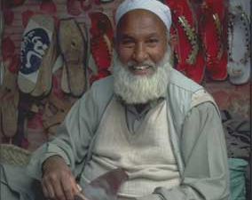
The Ultimatum Game
Notes:
Important Experiment that has been done many times, many places, etc…. In the field of Economics.

Slide 36
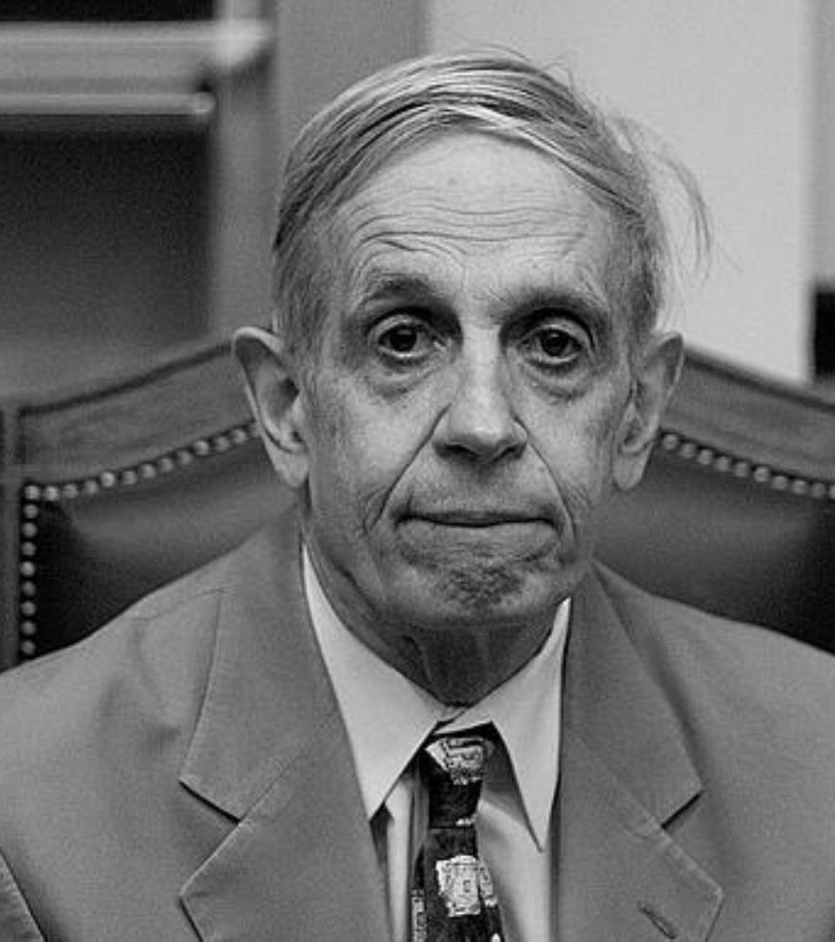
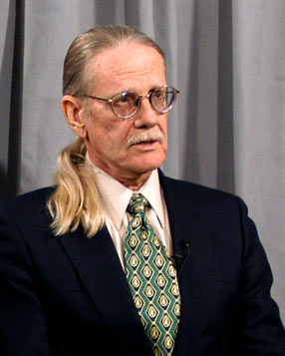
History
John Nash – 1994 Nobel Prize in Economics for his work in game theory
Game Theory – the study of interactions in which the results of one person’s choices depend not only on his own behavior, but also on the choices made by another person.
Vernon Smith – 2002 Nobel Prize in Economics for experimental economics, which builds on game theory.
Notes:
John Nash: Girls walk in… which would you approach? The prettiest… NO, she wouldn’t go out with you and all the rest of the girls would be mad because you went after the “pretty” one = consider other’s choices when making your own choice.
Vernon Smith: Experiments like this Ultimatum Game and Broadband Auction… etc.

Slide 37
“These experiments create an empirical challenge to what we call the
selfishness axiom—
the assumption that individuals seek to maximize their own material gains in these interactions and expect others to do the same.”
~Joseph Henrich, Emory University –Completed a 4-continent research project in which the Ultimatum Game was played in 15 indigenous societies.

Slide 38
Debrief
If individuals “seek to maximize their own material gains,” and assume that other people do, too, what will proposers do?
Why? (explain their thinking)
Notes:
EVERY offer should be 9:1

Slide 39
Debrief
If individuals “seek to maximize their own material gains,” and assume that other people do, too, how will responders react to proposals?
Why?

Slide 40
Results of Large Numbers of Ultimatum Game Experiments*:
the modal (most common) split is
50% - 50%
the mean (average) split is about
60% - 40%
about 20% of low offers are rejected
*Games conducted with college students in the U.S. and other developed countries. Students were paid to participate. Stake was the equivalent of $10 U.S. Results are considered to be “robust.”

Slide 41
Debrief
The results of ultimatum games are inconsistent with the model of economic man that predicts material self-interest (selfishness).
Note, especially, the rejection rate.

Slide 42
Proposed Explanations
“Other-regarding” Behavior
  We gain satisfaction not only from our lives (as the homo economicus model predicts), but also from the lives of others.
Notes:
Other-Regarding behaivor: Maybe but Research says this isn’t the biggest explanation
Fairnes: Rejected.

Slide 43
Proposed Explanations
Players demand fairness, and punish unfair behavior on the part of proposers.
  Responders take into account not just the amount of money offered but also the percent of the total.
  Vernon Smith’s new “trust game” research supports this hypothesis. Hurtful actions (injustice) merit punishment, while justice (want of injustice) merits no reward
Notes:
Other-Regarding behaivor: Maybe but Research says this isn’t the biggest explanation
Fairnes: Rejected.

Slide 44
Proposed Explanations
More equal splits may be less the result of fearing punishment for being unfair than they are the result of individuals’ concern for their reputations
  This is consistent with the results of experiments comparing the behavior of people in market and non-market economies (also consistent with Adam Smith’s observations)
Notes:
Other-Regarding behaivor: Maybe but Research says this isn’t the biggest explanation
Fairnes: Rejected.

Slide 45
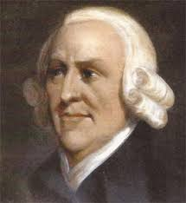
“A dealer is afraid of losing his character, and is scrupulous in observing every engagement. When a person makes perhaps 20 contracts in a day, he cannot gain so much by endeavoring to impose on his neighbors, as the very appearance of a cheat would make him lose.”
~Adam Smith – Wealth of Nations

Slide 46
“Markets require that even those persons who are not particularly other-regarding in their personal lives become so in their market behavior. Since market exchanges are voluntary, and since the objects the purchaser might acquire are many, entry into the market obliges sellers to become to an important degree other-regarding.”
~Michael Novak – Business as a Calling

Slide 47

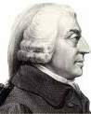
Proposed Explanations
Adam Smith’s “Impartial Spectator”
We view our behavior through the eyes of an impartial spectator.
- Theory of Moral Sentiments
Notes:
It’s about the INSTITUTIONS

Slide 48
Proposed Explanations
Reciprocity? Vernon Smith’s variations on the Ultimatum Game suggest that reciprocity motivates people.
  Variations of the Ultimaturm Game
  Earned right to be the proposer
  Dictator Game
  Presented as “transaction” rather than “ultimatum”
  If innate sense of fairness is the motivator, why are offers different?
  Centipede Game: reward the other person for not being selfish, hoping for reciprocal generosity on their turn.

Slide 49
Conclusions Based on Continued Research
Behavior in none of the 15 less-developed societies was consistent with the selfishness axiom.
Size of the Stake matters – very high stakes yield lower offers and lower rejection rates.
Individual differences do not explain ultimatum game outcomes
  age
  gender
  socio-economic status
  risk-aversiveness
However . . .

Slide 50
Conclusions based on continued research:
Group Differences Matter
  in the routine degree of economic cooperation in everyday life (EX: Whaling Communities)
    And…
  in the degree to which markets are an integral part of society
Group differences are significant in explaining experimental outcomes
Notes:
Group differences DO MATTER
EX: Whaling societies – you don’t catch whales by yourself.
The degree to which markets are integrated in society and the more they interact in markets, the more “fair” the splits.

Slide 51
Thus, we return to INSTITUTIONS
PERHAPS…. The way people play the ultimatum game reflects the way they interact in everyday life.
  Splits are more equal in cultures where people commonly exchange products and labor in markets.
  Markets are institutions through which societies develop distinctive patterns of interaction, which may be internalized and reflected in ultimatum game behavior.

Slide 52
Food for Thought (or assessment…)
Suppose that someone argued that capitalism is not good for the poor because it makes people greedy and selfish and encourages them to ignore others and think only of themselves. How could you use the results of ultimatum game experiments to counter that argument?

Slide 53
Our Results…

Slide 54
Paul Heyne, The Senior Economist, April 1995
Perhaps the most common moral objection to market systems is the one that asserts they are based on universal selfishness. Is that true? . . .
Economic theory assumes self-interested behavior. Self-interested behavior is selfish behavior only if one’s interests are selfish. We could avoid confusion on this score by saying that economic theory assumes people act to further the projects that interest them. Whether those projects are entirely or primarily selfish depends on what kind of people they are. We should probably be slow to judge. What do we really know about other people’s motives? . . .

Slide 55
Paul Heyne, The Senior Economist, April 1995
The moral critics of capitalism . . . might reply, ‘people are motivated primarily by money.’ And that is certainly true. But what does it mean? Suppose you are a teacher who has been asked to sponsor the debate club. You don’t really want to do it, but you agree when you are offered an extra $200 a month in salary. Were you motivated in this case by the money? It would seem so. But what does it tell us? It does not tell us you are interested only or primarily in money, because money is always a means to some other end. Suppose Ms. Demosthenes wants the money in order to increase her contributions to the local children’s hospital, and she will be giving up her regular bowling nights in order to find the time. Mr. Cicero will use the extra money to ACCEPT himself a new set of golf clubs and will find the time by preparing less carefully for his classes. Both Ms. Demosthenes and Mr. Cicero did it for the money, but what a world of moral difference we find in why and how they really did it.

Slide 56
Economics for Leaders
Activity: In the Chips

Slide 57
How to Play “In the Chips”
Your Goal: Make as much profit as you can over the course of the game.

Slide 58
How to Play “In the Chips”: BUYERS
Buyers: Each buyer will have only one buyer card at a time. It will say, “You are authorized to buy a box of computer chips. Pay as little as possible. If you pay more than ______ per box, you lose money.”
To make a “profit,” buy at a lower price than the price shown on your card. If you buy at a higher price, you suffer a loss.
Record the buyer card price & transaction price on your student score sheet.

Slide 59
How to Play “In the Chips”: SELLERS
Sellers: Each seller will have only one seller card at a time. It will say, “You are authorized to sell one box of computer chips for as much as possible. If you accept less than ______ per box you lose money.”
To make profit, sell at a higher price than the price shown on your card. If you sell at a lower price, you suffer a loss.
Record the seller card price & transaction price on your student score sheet.
REPORT TRANSACTION PRICE TO TEACHER

Slide 60
How to Play “In the Chips”: EVERYONE
When I say “GO,” sellers and buyers are free to move around the room and to make transactions with one another. Any seller may talk with any buyer.
Both buyers and sellers are free to make as many transactions as they want in a round
Remember to trade in your card after each transaction.
During the game, keep track of your progress on the student score sheet.
In between rounds, compute your gains and losses by taking the difference between the price on your buyer or seller card and the price of the transaction.

Slide 61
Let’s Play!

Slide 62
Debriefing
Who made money?
Who made the most money?
  Strategies?
Who lost money?
  Why?

Slide 63
Debriefing
What conditions made the market work well?
  Equal number of buyers and sellers
  like products for sale
  equal or full knowledge about the products
  clear rules concerning what you could/could not do in market

Slide 64
Debrief
What can you tell me about price in the various rounds?
In which round was there the greatest spread in transaction prices? Why?
Why did the transaction prices become more concentrated in the final rounds?

Slide 65
Debrief
Who determined the “market price” for computer chips?
Buyers? Where would they have set the price if they'd had the power to do so?
Sellers? Where would they have set the price if they'd had the power to do so?
Would you describe this as a competitive market?
Who was in competition with whom?

Slide 66
Debrief
How does opportunity cost explain a high price on a seller card? A low price on a buyer card?

Slide 67
Economics for Leaders
Activity: Market for Thingamajigs

Slide 68
How to Play - BUYERS
Goal: PROFIT
Each buyer will have only one buyer card at a time. The card will allow you to buy ONE thingamajig and will tell you how much you value it. To make a “profit,” buy at a lower price than the price shown on your card. If you buy at a higher price, you suffer a loss.
Record the buyer card price on your student score sheet.
When the round starts, try to buy below your buyer-card price – the lower, the better. (You may buy at a price higher than that on your buyer card, but note that this will reduce your “profit” for the round.)

Slide 69
How to Play - SELLERS
Goal: PROFIT
At the beginning of each round, each seller will be given an inventory of 10 Thingamajigs and a role card with the cost per thingamajig.
To make profit, sell at a higher price than the cost. If you sell at a lower price, you suffer a loss.
Record the transaction prices as you sell on your seller score sheet.
In between rounds calculate your profits.

Slide 70
How to Play - EVERYONE
All stores are open to all buyers.
When a buyer and seller agree on a price, they record the transaction on their transaction records, and the seller gives the Thingamajig to the buyer.
The BUYER must then report the transaction by turning in the Thingamajig card to the person keeping the Market Tally in the front of the room. The buyer may then exchange his buyer card for another and try to make another purchase.

Slide 71
How to Play - EVERYONE
When the teacher says “Start,” sellers and buyers are free to move around the room and to make transactions with one another. Any seller may talk with any buyer.
Both buyers and sellers are free to make as many transactions as they want in a round. Buyers, remember to turn in your Thingamajig card to the tally keeper and get a new buyer card after each transaction.
During the game, keep track of your progress on the student score sheet. Compute your gains and losses by taking the difference between the price on your buyer or seller card and the price of the transaction.

Slide 72
Let’s Play!
ROUND 1

Slide 73
Let’s Play!
ROUND 1
ROUND 2
ROUND 3
ROUND 4
Notes:
Round 1: Regular (don’t run out of inventory)
Round 2: Higher Value cards (disaster)
Round 3: Opportunity for Buyers to get more
Round 4: Price Ceiling

Slide 74
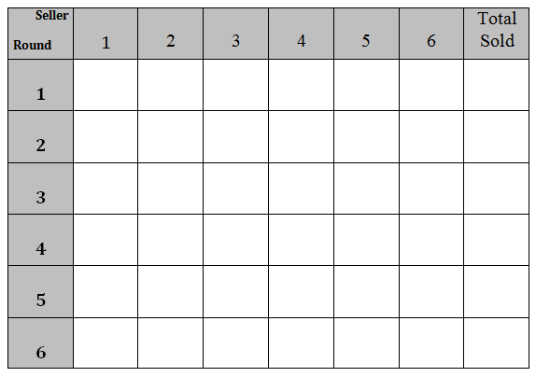
Transaction Tally

Slide 75
Economics for Leaders
Activity: Job Jungle
Job Jungle, Copyright 1988 - Raymond P. H. Fishe, all rights reserved.

Slide 76
1 Kitchen - How Many Cooks?
# cooks | #pizzas made | # additional pizzas from hiring this cook? | What happened?
0 | 0 | 0
1
2
3
4
5
6
No Cook – No Pizza !
10
10
Good cook – does everything himself
25
15
1 baker, 1 prep and waiter
45
20
1 baker+1 prep+1 waiter – what a system!
55
10
Extra guy – helps who ever is behind
55
0
Things aren’t so hectic
40
-15
Get her out of the way !
Would you hire 6 cooks?
What's the most you'd be willing to pay cook #4?
Notes:
After you go through all the numbers, then say: “What if… pizzas sell for $10?” Then what’s the most I’d be willing to pay the 4th worker? What’s the marginal benefit of a worker? A: The value of the additional pizzas they make.

Slide 77
Two Types of Jobs
Skilled Jobs
Unskilled or low-skill jobs
Bookkeeping
Marketing
Design
Advertising
Shipping & Ordering
Taking orders
Cutting Patterns
Sewing
Printing
Labeling
Packing
Delivery

Slide 78
JOB JUNGLE: Output, Marginal Product, and Marginal Revenue
Price of Kites (P) = $_________
$10
YELLOW CARD WORKERS (unskilled) |  |  |  |  | Pink Card Workers (skilled)
# Hired | Kites Made | Added Product (MP) | P xMP |  | # Hired | Kites Made | Added Product (MP) | P x MP
1st | 5 | 5 | $50 |  | 1st | 8 | 8 | $80
2nd | 8 | 3 | $30 |  | 2nd | 14 | 6 | $60
3rd | 10 | 2 | $20 |  | 3rd | 19 | 5 | $50
4th | 11 | 1 | $10 |  | 4th | 22 | 3 | $30
5th | 12 | 1 | $10 |  | 5th | 24 | 2 | $20
6th | 12 | 0 | $0 |  | 6th | 25 | 1 | $10

Slide 79
If You Are a Worker . . .
Your goal is to make an income – the more the better! (You'll use this income to purchase the goods and services you want and need. The more income you have, the higher your standard of living.) The worker with the most income at the end of the game wins a prize.
A worker earns income by finding an employer who will hire her at a mutually acceptable wage.
All workers start with some money – as indicated on the top of the card. Workers start with different amounts of money because that's the way things are.

Slide 80
If You Are a Worker . . .
All workers begin with YELLOW cards and are unskilled. You may not negotiate for a PINK card job when you have a yellow card.
A job lasts for only one round. At the beginning of each round, you are unemployed.
The wage is for the round and you may only be hired once each round.

Slide 81
If You Are a Worker . . .
If you agree to be hired by an employer, have the employer enter the wage on your card and initial it. Once you make a deal, you may not back out or look for a better offer.
After you get a job, return to your seat and total your income.

Slide 82
If You Are a Worker . . .
At the end of a round, you may buy an education from the teacher for $25.
To buy an education, you must have $25 on your yellow card. No loans allowed.
The teacher will take your YELLOW card, subtract $25, and enter any remaining $ on a PINK card. When you have a BLUE card, you may try to get high skilled jobs.

Slide 83
If You Are an Employer. . .
The employer's goal is to make profit – the more, the better! To make profit, you have to produce KITES. To do that, you have to hire workers:
You hire low-skilled (YELLOW card) workers to act as cutters, sewers, and printers.
You hire high-skilled (PINK card) workers as designers, marketing specialists, accountants, etc.

Slide 84
If You Are an Employer. . .
Refer to the "Output" charts in making your hiring decisions. Not all workers are of the same value to you.
The output scales are independent. If you hire 2 YELLOW card workers and then hire a PINK card worker, the PINK card worker's wage goes on the "1st" line of the PINK card worker chart.

Slide 85
If You Are an Employer. . .
The wage is for one round only. At the beginning of each round, you start over hiring workers.
When you hire a worker, write the wage on his card with your colored pen and initial it. You may not back out on a deal to hire a worker once you've made an agreement.
Also record the hire in the “wage paid” column of your profit calculation sheet.
At the end of each round, figure profit for that round.

Slide 86
Round #2 – Wages Paid |  |  |  |  |  | Round #2 – Profit Calculation
YELLOW Card |  | PINK Card |  |  |  | # Kites produced (pink+yellow) |  |  | (from chart)
Worker | Wage | Worker | Wage
Hired | Paid | Hired | Paid |  |  | X Price of kites |  |  | X $ 10
1st |  | 1st |  |  |  |  |  |  | = $
2nd |  | 2nd |  |  |  | = TOTAL REVENUE
3rd |  | 3rd
4th |  | 4th |  |  |  |  |  |  | — $
5th |  | 5th |  |  |  | — TOTAL COST
6th |  | 6th |  |  |  |  |  |  | $
 |  |  |  |  |  | = PROFIT Round #2
Sub-total |  | +Sub-total |  |  | = | Total cost

Slide 87
Minimum Wage?

Slide 88
Unemployment Insurance?

Slide 89
JOB JUNGLE: Output, Marginal Product, and Marginal Revenue
Price of Kites (P) = $_________
$15
YELLOW CARD WORKERS (unskilled) |  |  |  |  | Pink Card Workers (skilled)
# Hired | Kites Made | Added Product (MP) | P xMP |  | # Hired | Kites Made | Added Product (MP) | P x MP
1st | 5 | 5 | $75 |  | 1st | 8 | 8 | $120
2nd | 8 | 3 | $45 |  | 2nd | 14 | 6 | $90
3rd | 10 | 2 | $30 |  | 3rd | 19 | 5 | $75
4th | 11 | 1 | $15 |  | 4th | 22 | 3 | $45
5th | 12 | 1 | $15 |  | 5th | 24 | 2 | $30
6th | 12 | 0 | $0 |  | 6th | 25 | 1 | $15

Slide 90
Economics for Leaders
Activity: Cartels & Competition

Slide 91
The Producers…
6 companies…
do 98% of the business in this industry.

Slide 92
The Producers
Your goal: make as much profit as possible
Prizes for ALL companies that earn MORE than $200 profit!
Additional prize for company that earns the MOST profit!

Slide 93
Demand Forecast
PRICE
MARKET DEMAND (QD)
$125
$100
$75
$50
$30
$25
$20
0 – 6
7 – 13
14 – 19
20 – 26
27 – 32
33 – 40
41 – 50

Slide 94
Production Decision Worksheet
Let’s Practice…

Slide 95
Demand Forecast
PRICE
MARKET DEMAND (QD)
$125
$100
$75
$50
$30
$25
$20
0 – 6
7 – 13
14 – 19
20 – 26
27 – 32
33 – 40
41 – 50

Slide 96
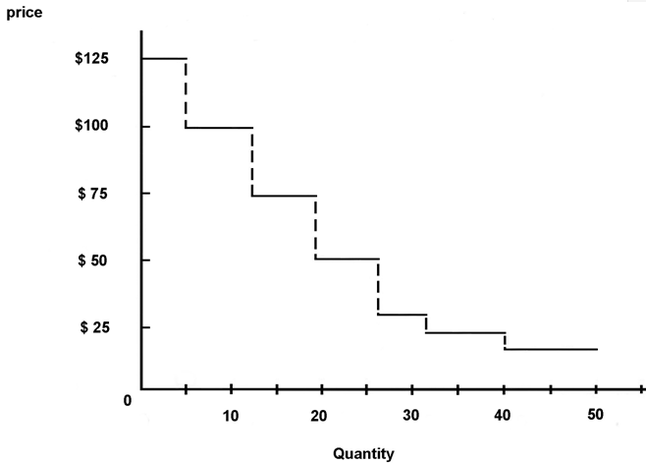
Market Demand
Price
$125
$100
$75
$50
$30
$25
$20
QD
6
13
19
26
32
40
50

Slide 97
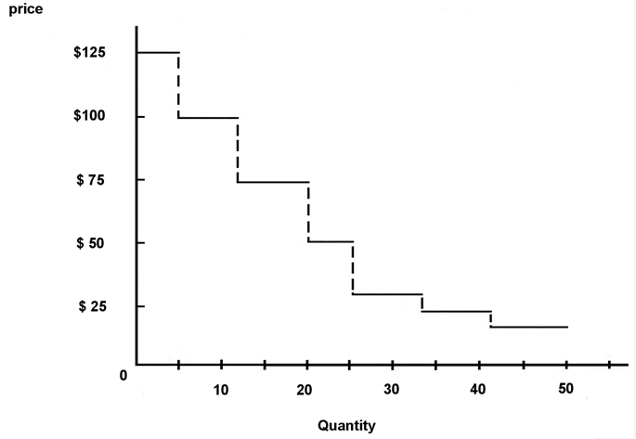
Market Demand
Price
$125
$100
$75
$50
$30
$25
$20
QD
5
12
20
25
34
42
50

Slide 99
Economics for Leaders
Activity: Farmers & Fishers

Slide 100
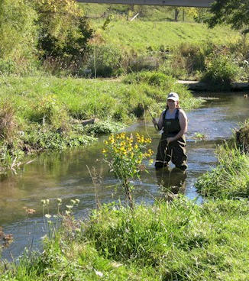
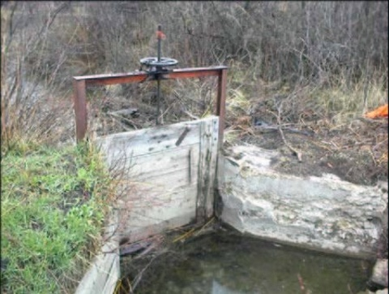

United States
(surface) Water Law
Riparian (roots in English common law)
  Typical in the East
  People who own land along streams, lakes, springs, etc., have a right to reasonable use of the water.
  Historical use protected by law from new uses

Slide 101
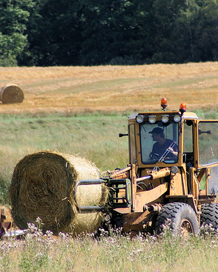
United States
(surface) Water Law
Prior appropriation (spontaneous response to conditions)
Typical in the West
The first person to divert water (take it out of the stream) and use it, has the first right.
People who come after may claim water that is left after the first user has fulfilled his right.
“Ownership” of water rests with the state
Water right is a use right only, and is measured in cubic feet/second

Slide 102
Water Law - Terminology
Use-It-or-Lose-It: If rights-holder doesn’t use all of the water claimed, the right is lost and the water right reverts back to the state
Salvaged Water Rule: If a person saves water (e.g., with better irrigation), he cannot sell the extra water or even keep his right to it. (Ownership reverts to the state.)
Beneficial Use: People may not establish water rights unless they are using the water for “beneficial use”, as determined by state law. For example, agriculture is considered a beneficial use in all states, but only some states recognize recreation or fishing as beneficial uses.
Public Interest: Water rights ― especially the right to transfer ― are limited by the “public interest,” which may include protecting an economic area or the environment, or public health and safety.

Slide 103
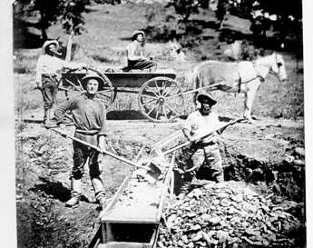
The “rules of the game” make a difference in the level of conflict over water.
Example:
Joe and Frank are gold miners. Joe sets up his camp on a stream, builds a sluice, and diverts 10cfs (cubic feet per second) of water through the sluice. Frank arrives one month later and builds his camp upstream from Joe. His sluice only uses 5 cfs of water, but in August when Frank takes out water, only 6 cfs are left for Joe.
Suppose the property rights rule is riparian common law. What happens?
Suppose the rule is prior appropriation (first-come, first-served). What happens?

Slide 104
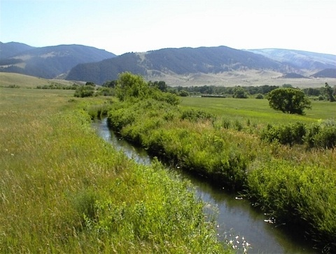
Scenario
A small town lies at the lower end of a valley in which five farmers raise some market crops and hay to feed their livestock. The farmers, whose families settled the area in the 19th century, irrigate their fields in dry years with water from a stream that flows from the snowfields of the mountains at the head of the valley.
Most of the people in the town work for the farmers or supply goods and services related to farming. The exception is the Outfitter, a family-owned business that serves big game hunters during the fall hunting season and bird hunters throughout the winter.

Slide 105
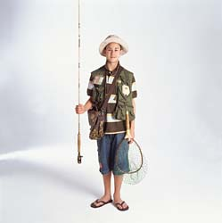
When Orley Outfitter came back from college in the city, he convinced his father that “city dudes would pay big bucks to fish in our stream.”
Turned out, Orley was right! Boom town! Orley began hiring local kids to work as guides and their moms to work in the fishing supply shop. The local diner stays open all week and the gas station gets several deliveries a month instead of one.
Everything was great . . . until

Slide 106
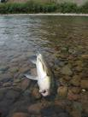
After a beautiful, dry winter (which everybody loved – not a single football game was canceled at the high school!), the river was low.
When the farmers opened up the headgates to irrigate their hay fields, the river below town all but dried up, and the water got very warm. Soon, more fish were floating belly-up than swimming.

Slide 107
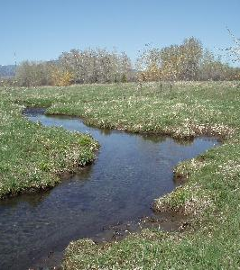
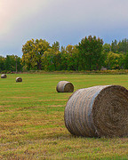
Word spread and fishermen began to cancel their vacations. The Outfitters were panicky; it looked like they would lose most of their yearly income!
And then they got mad. The farmers didn’t have to irrigate; their hay would still grow. True, they would only get 2 cuttings instead of 3, but that wouldn’t hurt them as much as the low water was hurting the Outfitters! It didn’t seem fair for the farmers to hog all the water.

Slide 108
A Town Meeting Has Been Called
Roles: You will be either a farmer or an outfitter. (It is up to you whether or not to share the information on your role card.)
The challenge to your group is to solve the problem that is threatening to disrupt your community.
If you come up with a solution that I cannot improve upon, you get to keep the prize I’ve put on your table. If I can improve on your solution, your group forfeits the prize.
The problem is immediate – now, this summer, here, in this town! Don’t waste time with pie-in-the-sky solutions to fix the world for all time

Slide 109
“Rules of the Game”
The farmers have the water rights under prior appropriation.
There is NO use-or-lose it provision in the law.
There is NO salvaged water provision in the law.
Beneficial uses include: diversion for agriculture, industrial, mining, and domestic water supplies; and in-stream use for recreation and conservation

Slide 110
A “Better” Solution Is One That:
Makes the farmers better off without hurting the fishermen
Makes the fishermen better off without hurting the farmers, or
Makes both the farmers and the fishermen better off

Slide 111
Stop here – solution slide follows

Slide 112
The range of possibilities
 |  | Farmers $75,000
 | HIGH Water yrs.
 |  | Outfitters $100,000
WATER |  |  | Farmers $75,000
 |  | Farmers irrigate
 |  |  | Outfitters $20,000
 | LOW Water yrs.
 |  |  | Farmers $50,000
 |  | irrigate
 |  |  | Outfitters $100,000
Farmers DON’T

Slide 113
The Range of Mutually Beneficial Solutions
WATER |  |  | Farmers $75,000
 |  | Farmers irrigate
 |  |  | Outfitters $20,000
 | LOW Water yrs. |  | $50,000
 |  | irrigate
 |  |  | Outfitters $100,000
$25,000
difference
$80,000
difference
Farmers DON’T

Slide 114
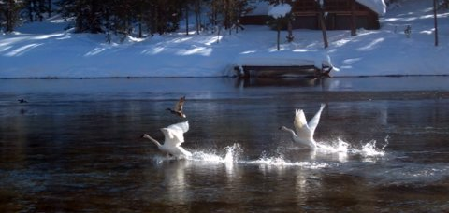
Trumpeter Swans and Idaho Farmers – A “willing seller, willing buyer” exchange based on clearly defined property rights to water.

Slide 115
It's not the people;
it's the system.
Notes:
It’s not about good guys and bad guys. It’s the Institutions and Incentives.

Slide 117
Activity: Fish Game

Slide 118

The Fish Game
Rules:
  0 to 10 seconds: $0.25 per fish
  10 to 20 seconds: $0.50 per fish
  Game ends when all fish taken.

Slide 122
Economics for Leaders
Activity: A Pollution Solution

Slide 123
The Problem
In the process of producing goods and services valued by people throughout the region, 3 firms in your town emit into the air a total of 90,000 tons of Yuk annually.
All 3 firms have reputations for quality products.
All 3 employ large numbers of local citizens and pay taxes that represent a substantial portion of the budgets of local governments.

Slide 124
The Problem
The federally-legislated allowable level of Yuk emissions for your region is 45,000 tons/yr.
Yuk emissions are monitored and measured by the AQCC, and penalties including fines and production shutdowns, are imposed on non-compliant regions.
The Air Quality Control Commission (AQCC), organized by local gov. officials and business owners, is responsible for ensuring compliance with the 45,000 ton limit in your region.

Slide 125
Potential Solutions & Costs
We COULD set a limit of 15,000 tons/firm
Cost to clean up pollution beyond the allowed 15,00 tons:
Firm A: $ 0
Firm B: $30,000
Firm C: $90,000
TOTAL: $120,000

Slide 126
Potential Solutions & Costs
Or we COULD require each individual firm to reduce emissions by 50%
COST TO CLEAN UP 50%
Firm A: $7500
Firm B: $30,000
Firm C: $67,500
TOTAL: $105,000

Slide 127
The Problem
The AQCC has decided that the “fairest” method is to make each business responsible for reducing pollution by half. To do this, the Commission issued 45,000 credits for the emission of 1 Ton of Yuk and gave each firm credits equal to ½ of its current Yuk emissions level.

Slide 128
The Problem
Firms may pollute up to the level of credits they hold without penalty and must pay to clean-up pollution for which they do not hold credits
Firm A: 7,500 ton credits
Firm B: 15,000 ton credits
Firm C: 22,500 ton credits

Slide 129
The Challenge
Can you clean up the Yuk
to 45,000 Tons
At a LOWER cost through trade?

Slide 130
GOAL:
Lower total clean-up cost without making any firm worse off.

Slide 131
Goal
Your firm has already budgeted to clean up half of your pollution and turn in credits for the other half.
Can you come up with a solution that is BETTER for you - that will cost less than your budgeted amount - and will still result in a reduction of pollution in your region to 45,000 Tons?

Slide 132
The Incentive:
$1/person on each team that meets emissions goal at lower cost than budgeted. (Teams that have a balance > zero.)
$5 for firm with the greatest percentage decrease in costs.

Slide 133
Procedure
Credits are valuable to you. 1T Credit is worth what it costs you to clean up 1 Ton of pollution.
You would only be willing to SELL a 1T credit if someone pays you MORE than it costs you to clean up 1 Ton of pollution.
You would only be willing to BUY a 1T credit if it costs LESS than cleaning up 1 Ton of pollution.

Slide 134
Procedures
Talk with your group and other teams to come up with a solution.
If you decide to BUY credits from other teams, write them a check for the agreed upon amount and record it on your balance sheet.
If you decide to SELL credits, collect the money (a check) and record it on your balance sheet.

Slide 135
Procedures
At the end of the simulation, you have 3 options:
  Turn in enough pollution credits to cover all your pollution
  Write a check to pay for “clean-up” of all your pollution
  Turn in credits for some of your pollution and write a check for “clean-up” of the rest

Slide 136
Solutions Follow

Slide 137
A Better Solution than just paying to clean-up:
Firm A’s costs below $7500
Firm B’s costs below $30,000
Firm C’s costs below $67,500

Slide 138
A Better Solution
Firms A and B sell the issued credits for more than the clean-up costs them.
(Price they sell for can be ANYWHERE between the LOWEST A and B would be willing to accept and the MOST firm C would be willing to pay.)
Price range $1.01 - $2.99/T

Slide 139
A Better Solution (@ low prices)
Firm A: CLEAN-UP COSTS
Reduces emissions by 15,000 T $15,000
Sells 7500T credits to Firm C for $1.01/T - $7,575
Total Cost for Firm A $ 7,425
Firm B:
Reduce emissions by 30,000 T $ 60,000
Sells 15,000T credits to Firm C for $2.01/T -$30,150
Total Cost for Firm B $29,850
Firm C:
Purchase 7500 T credits from Firm A $ 7,575
Purchase 15,000T credits from Firm B $30,150
Use own 22,500T credits $ _ 0
Total Cost for Firm C $37,725
TOTAL COST FOR 45,000T reduction = $75,000
Lower than the $120K or $105K cost of other solutions!

Slide 140
A Better Solution (@ higher price)
Firm A: CLEAN-UP COSTS
Reduces emissions by 15,000T $15,000
Sells 7500T credits to Firm C for $2.99/T -$22,425
Total Cost for Firm A $ -7,425
Firm B:
Reduce emissions by 30,000 T $ 60,000
Sells 15,000T credits to Firm C for $2.99/T -$44,850
Total Cost for Firm B $15,150
Firm C:
Purchase 7500 T credits from Firm A $22,425
Purchase 15,000T credits from Firm B $44,850
Use own 22,500T credits $ _0
Total Cost for Firm B $67,275
TOTAL COST FOR 45,000T reduction = $75,000
Note: Negative clean-up costs mean that in this scenario Firm A is getting paid to clean up!
Lower than the $120K or $105K cost of other solutions!

Slide 141
Debrief
What was the least-cost method of meeting the required pollution standards?
  A market for emissions credits
Why is this the least cost method?
  The market coordinates the information each firm knows (own cost of clean-up) – and provides incentives for clean-up to be undertaken by the firms with the lowest clean-up costs.

Slide 142
Debrief
What is the incentive for firms to adopt the emissions trading?
  $$$$$
Why did (might) some groups NOT reach this solution?
  It may be that they did not think of trading, or that one firm refused to trade. Markets require willing buyers and sellers.

Slide 143
Debrief
What is the significance of property rights in this activity?
  They are necessary for a market to emerge, and it is the emergence of the market that allows the reduction of pollution at least cost.
  When property rights are unclear, no market will develop and the remaining options for pollution reduction are more costly.

Slide 144
Debrief
The property right in question here: AIR
What are the privileges and limitations to use of the air, and who has those rights?
  Prior to the federal mandate to reduce pollution the property rights were unclear.
  The mandate and the issuing of emission credits defined the rights – each firm had the right to use the air to emit as many tons of pollutant as it had pollution credits.

Slide 145
Debrief
The U.S. uses pollution markets – called Cap and Trade programs – and real firms in our real economy buy and sell emissions credits. For ex., since the 1990s, a market has helped reduce SO2 emissions from coal-fired power generating plants. Markets also exist for Nitrous Oxide emissions and for carbon offsets. What are the key features necessary for an emissions Cap and Trade program to work?

Slide 146
Conclusion
Property Rights for credits must be clear, enforceable (= must be traceable), and transferable.
The transaction costs of buying and selling credits must be low enough for firms to participate willingly.
The rules of the game must allow (not prohibit) markets.

Slide 148
Economics for Leaders
Foreign Currencies & Foreign Exchange

Slide 149
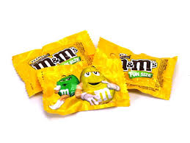
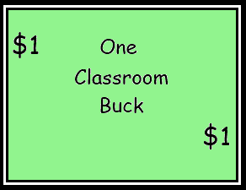
For Sale

Slide 151
Riyals for Bucks?
 | 1 | 1 | 1 | 1 | 1 | 1 | 1 | 1 | 1 | 1 | 1 | 1 | 1 | 1 | 1

Slide 152
Debrief
What happened to the price of candy?
What happened to the price of a buck?
Why?

Slide 153
What is money?
Medium of Exchange
Store of Value
Measure of Value
Foreign currencies serve all of these functions too!

Slide 154
How much is money worth
Whatever people are willing to exchange for it!
Supply and Demand
Less demand for a country’s currency?
Greater supply?

Slide 156
Videos Used at EFL
Monday Afternoon/Evening: World Poverty and Economic Growth
Hans Rosling and The Magic Washing Machine http://www.youtube.com/watch?v=BZoKfap4g4w
Hans Rosling’s 200 Countries, 200 Years, 4 minutes http://www.youtube.com/watch?v=jbkSRLYSojo
Lesson 1
from minute 1:00 thru 2:30 of http://www.youtube.com/watch?v=Nt4aWojF9Rg Poverty in Africa – In Your Eyes
Fire Department Auction: http://www.youtube.com/watch?v=bnjQ3cV4×1I
Greed http://www.youtube.com/watch?v=RWsx1X8PV_A Milton Friedman interview by Phil Donahue
Lesson 2
“Gridlock” http://reason.tv/video/show/6.html – Drew Carey – Section 4:15 – 6:10 opportunity cost analysis as a father compare the several hundred dollar monthly bill for access to the private toll lanes in Orange County to the $5/min/child he and his wife pay when they’re late to pick up their three kids from daycare.
Marginal Analysis – Negotiating with the Dentist: http://www.youtube.com/watch?v=7_qwjcxwUqw
Lesson 3
Ethanol – Silly Senator, Corn Is for Food http://reason.tv/video/show/462.html – Reason TV
Organ Transplants – Kidneys for Sale? http://reason.tv/video/show/333.html Drew Carey start at about 5 min – good overview of for and against (also lesson 2 opp cost and 4)
Prisoners’ dilemma: http://www.youtube.com/watch?v=p3Uos2fzIJ0 – British game show – Golden Balls – Split or Steal?
Hudsucker Proxy http://www.youtube.com/watch?v=D2QlitH4nYY

Slide 157
Videos Used at EFL
Lesson 4
Throw-Pillow Fight- Is your interior designer really putting your life at risk? http://reason.tv/video/show/741.html – using licensing restrictions to reduce competition.
Lesson 5 – entrepreneurship
Food Fight – Battle of the Bacon Dogs http://reason.tv/video/show/392.html – Drew Carey – government licensing of street vendors – “People just want the bacon” (would also work well in lessons 3, 4 & 8.)
Lesson 6 – Labor
Mexicans and Machines – Why it’s time to lay off NAFTA http://reason.tv/video/show/451.html Drew Carey –
Lesson 8 – Actions of government
http://reason.tv/video/show/392.html Food Fight – Battle of the Bacon Dogs – Drew Carey – government licensing of street vendors – “People just want the bacon”
http://reason.tv/video/show/741.html Throw-Pillow Fight – Is your interior designer really putting your life at risk? – using licensing restrictions to reduce competition.
http://www.youtube.com/watch?v=cWt8hTayupE&NR=1 Obama Budget Cuts Visualization – start at 0.10 (We humans have a problem with big numbers – takes out the first 10 seconds which is criticism of Obama) Piles of pennies used to show how big the federal budget is, what portion of the budget is discretionary, etc.
Lesson 9
http://www.pncchristmaspriceindex.com/CPI/index.html PNC Christmas index, 2009
Lesson 10
Drew Carey http://reason.tv/video/show/451.html Mexicans and Machines – Why it’s time to lay off NAFTA – (See notes in lesson 6 above.)

